Slide 1

Proposal for System Integration
--- Methodologies and Approaches of Integration between OMNEX products and SAP ERP system

Slide 2
Agenda
Requirements Collection and Understanding
System Integration Feasibility Analysis
System Integration Landscape
System Integration Design

Slide 3
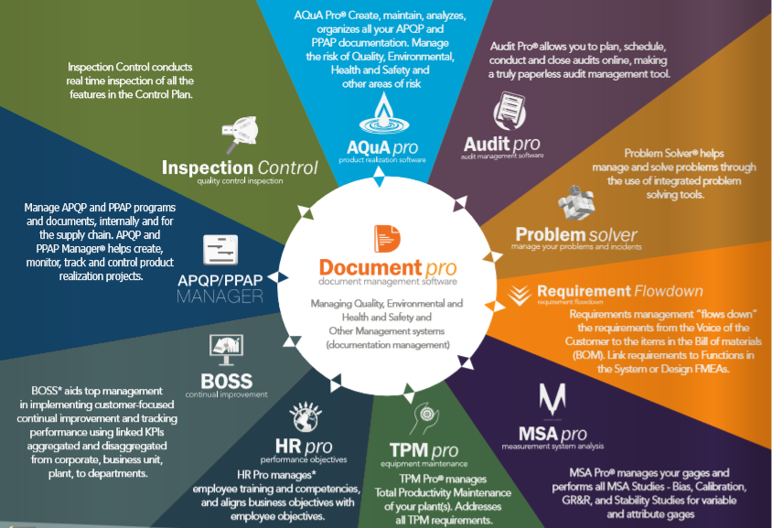
Omnex Products Portfolio

Slide 4










Omnex Products Portfolio

Slide 5
Requirements of System Integration
Analysis
Most of the automotive (or related) firms are using SAP ERP (or other core business system) to manage their business data and transactions.
As a part of the SCM, OMNEX products become more and more important, and are playing the critical role in the daily work of each company.
In most of the cases, the master data of an company is always managed by the ERP system(the leading system) and will be consumed by ERP itself and other external system as well. And, Omnex products will also need to consume the master data (like supplier information, parts information, and etc.)
The integration between Omnex products and ERP system becomes a critical demand with high priority and has been requested from most of our implementation projects.
As the most critical core system, ERP systems are only used in the company internally(internal network or VPC) according to the requirements of system security and stability.
As of now, there are only few ERP related business object configured in Omenx products, and no completed end to end integration approaches predefined also.

Slide 6
Requirements of System Integration
Goals
To handle the most common and important master data (current phase) that will be consumed by Omenx products (such as supplier info, parts info) in ERP system.
To handle the most popular and stable data transfer protocols in the integration scenario.
The integration between Omnex products and ERP system should consider the following requests:
Network security
Data security
Timeliness of the data transferring
Access right control
To ensure the independence, security, scalability, flexibility for Omnex products.
The integration approach should be built at product level and can be reused in most of the implement project in the future.

Slide 7
System Integration Feasibility Analysis
DMZ
?
Core System
SRM
CRM
ECC
Others
APQP/PPAP
Data Exchange
OMNEX Products
Customer Systems
MSA
Functions Invoke
BOSS
DOC
…
Security Control
AUDIT
Web based multi functions application.
Consume the master data of firm core system.
Can be accessed by external users or customers.
Can be deployed on public/private cloud.
?
Internal core business system, could be built base on special technology.
The leading system of master data.
Can be accessed by internal users inside the company network only.
Deployed inside the company network.
Open
Security
Performance
Extendable

Slide 8
System Integration Feasibility Analysis
PI
Process Integration
A SAP Product
Customization is required to realize the integration (content management)
Applicable for the customers who have PI installed.
HCI
HANA Cloud Integration – Process Integration
A SAP Product (cloud service)
Customization is required to realize the integration (content management)
Applicable for the customers who have subscribed the cloud service.
Customized Integration
Customization is required in SAP ECC, the third party Integration software is required.
Applicable for the customers who do not have the PI and HCI purchased.
Applicable for the customers who do not use SAP ECC product.

Slide 9
Applicable Matrix
 | SAP Product | Need Customization | Applicable for SAP Customer | Need Additional SAP Product or Service | Applicable for None-SAP Customer | Need Standard API in Omnex Product
PI
HCI
Customization
1
2
4
1
3
4
1
4
1
: Customization need to be done during implementation (content management, such as mapping work).
2
: The product SAP PI should be ready.
3
: The cloud service SAP HCI should be ready.
4
: Omnex products should have the open API in product level for external use.

Slide 10
System Integration – Using PI
SRM
CRM
Third Party External System
PI
All systems interaction will be handled by PI.
The data mapping should be customized in PI for each integration.
For third party external system, the products only need to focus on the standard OPEN API development.
Customer should pay for PI product and PI customization effort.
Other Internal System
ECC

Slide 11
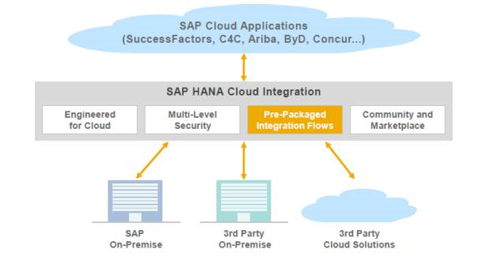
System Integration – Using HCI
All systems interaction will be handled by PI.
The data mapping should be customized in PI for each integration.
For third party external system, the products only need to focus on the standard OPEN API development.
Customer should pay for the SAP cloud service and customization effort.

Slide 12
System Integration Landscape - Customization
Public Cloud/Private Cloud
DMZ
Intranet
Omnex Product Suites
Integration Server
Customer Core Business System (ERP and others)
APQP/PPAP
BOSS
AUDIT
Web Services
Master Data
Initial Load
Supplier Info
Equipment Info
Parts Info
Master Data
Delta Load
User Info
Other Info
DOCUMENT
MSA
MSA
Data Cache
Extract
TPM
INSPECTION
OTHERS
Logs
SRM
CRM
ECC
Other Models
Business Objects can be leveraged by Core business System

Slide 13
Customized System Integration Landscape – Integration Server
Interact with backend system (SRM, CRM, ERP…).
Data exchange with backend system approaches can be:
SFTP
BAPI
Interact with frontend system (Omnex Products)
Data exchange with frontend system can be:
Restful Web Service
Can be installed within DMZ area to handle the data exchange between Omnex products and ERP system.
Can cache the business objects (such as supplier info) from ERP system to local.
Can record all data extracting and transferring process.
Secured approach is built inside.
Provide dashboard to view integration transactions.
Support manually interaction to handle exceptions.
Integration Server

Slide 14
Customized System Integration Landscape – Backend (BAPI)
Master Data Initial Post (Web Service Call)
1
Integration Server
The Initial master data post is triggered from ERP side and post via Web service. (BAPI for SAP ERP)
The delta master data post is triggered from ERP side and post via Web service. (BAPI for SAP ERP)
The front server also can receive the transaction data on demand to meet the extended business requirements.
Customer Core Business System (ERP and others)
Logs
Security Control
Web Services
Master Data Delta Post (Web Service Call)
2
Transactional Data Post (Web Service Call)
3
Data Cache

Slide 15

Customized System Integration Landscape – Backend (SFTP)
Transfer master data (initial and delta) using SFTP.
The master data post is triggered from ERP side and export to share drive. (the file format should be pre-defined)
Front server has a file extractor built inside to load the flat files from share drive.
The front server also can receive the transaction data on demand to meet the extended business requirements.
The schedule job and security control functions are built in integration server to support the flat file catching scenario.
Export
Load
Integration Server
1-2
1-1
Customer Core Business System (ERP and others)
Flat Files with time stamp
Cache
Schedule Job
File Extractor
2-2
2-1
Log
Load
Export
Security Control
Web Services
Transactional Data Post (Web Service Call)
3

Slide 16
Customized System Integration Landscape - Frontend
Front Server connect with Omenx products via Web services.
Security control, data cache and logs management are built in integration server.
Interfaces are predefined and standardized in front server to handle the interaction between front server and all Omnex products.
Omnex Product Suites
Integration Server
APQP/PPAP
Web Services
Master Data Initial Post (Web Service Call)
1
Interface to Omnex Products
Security Control
Logs
Master Data Delta Post (Web Service Call)
2
AUDIT
Data Cache
Transactional Data Post (Web Service Call)
3
BOSS
OTHERS

Slide 17
System Integration Design – Omenx Product Standard Open API
Supplier
Standardized Data Model API
Omenx Standard + SAP
Supplier_ID (PK)
Omnex Product Suites
Supplier_Name
Supplier_Address
SAP Integration Tool
APQP/PPAP
DOC
Web Services (Standard API)
….
AUDIT
MSA
Parts
Part_ID (PK)
BOSS
OTHERS
Part_Name
Part_des
….
Omenx E2E Standard
Supplier Data Model
Parts Data Model
Omenx Integration Tool
Other
Other Data Model
xxxx (PK)
xxxx
xxxx
….

Slide 18
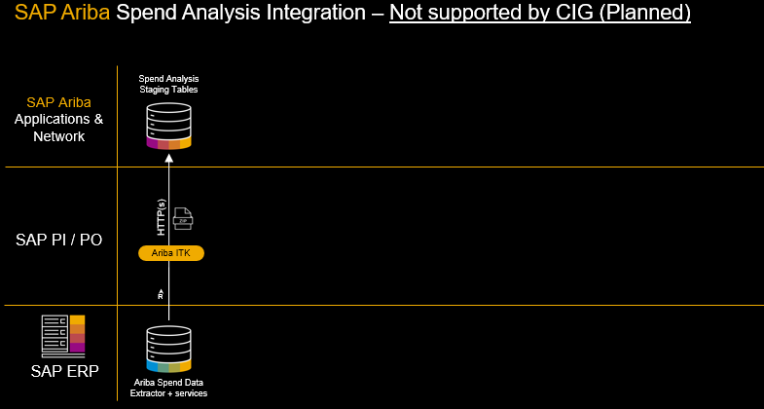
Integration Reference – SAP Ariba

Slide 19
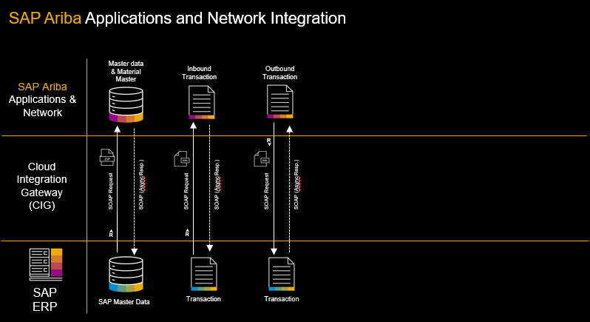
Integration Reference – SAP Ariba

Slide 20
Cost of SAP PI – (FOR REFERENCE ONLY )
Product License Fee
Cost of Implementation
Total Cost
For single PI product, SAP PI License Fee depends on the cores that the customer phased. Normally, 75k €.
If customer want to buy a suite of SAP products(like ECC, PI, CRM), the cost of PI could be 7% of total cost.
Cost of Implementation: for each customized integration, there should be additional development effort required. The final cost will depends on the effort of estimation of each customization. (for SAP experts, the cost of man-day ≈ 1k€ per man day)
It is quite complex to integrate with third party system using PI. (More Data transform and mapping efforts is required.)

Slide 21
Cost of SAP HCI – (FOR REFERENCE ONLY )
SAP Cloud Fee
Cost of each connection
Total Cost
As HCI is a cloud based product, so customer should pay the cloud service fee, it will depends on the particular services.
For HCI, the cost of HCI will depend on the connections that user want to use. Normally, one connection will cost 300¥ per month.
HCI will always be more easier to implement the integration customization within the SAP products environment. (it means that if all the systems need to be integrated are SAP products, the implementation should be easier than third party systems.)

Slide 22
Cost of Omnex Integration Server – (FOR REFERENCE ONLY )
Implementation Fee Only
Integration Server is an Omnex product which can be used in any of the integration scenarios.
Although the customization is still required during the project, however, the implementation fee could be reduce to the lowest level according to the OOTB functionalities of integration server product.
The integration server is developed based on JAVA technology, the complexity of the product is well controlled, and the product is also well designed to integrate with third party system easier.
On the other hand, the implementation cost also could be merged to the total project implementation cost.

